Slide 1
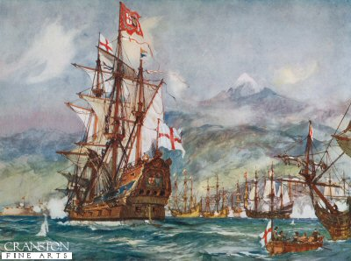
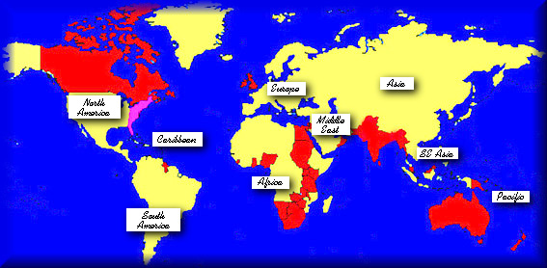
Britain Becomes a Global Power
Birth of the American Republic:
Trade with West Indies, N. America & India
controlled more colonies
Good climate for business
Winning most European Wars
Controlled slave trade $$$$
United with Scotland & Wales / free-trade
Controlled Ireland

Slide 2
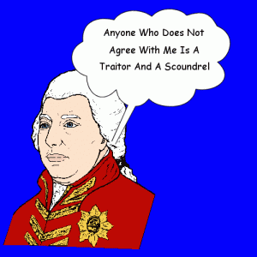
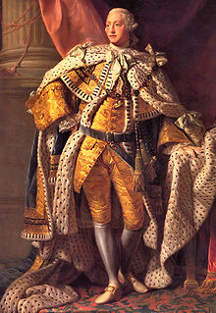
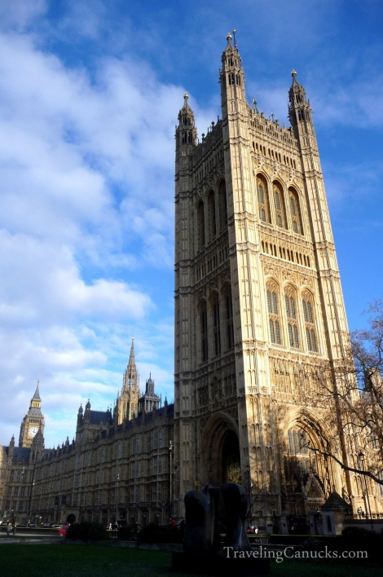
1760 – King George III began 60-year reign
Loved England – However….
Many of his policies were disastrous
Violated Colonists “Natural Rights”
Basically wanted to rule as an absolute monarch
Controlled Parliament – picked and fired Prime Ministers at will.

Slide 3
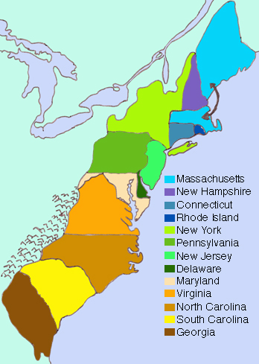
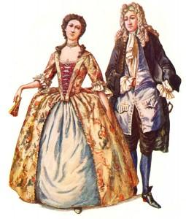
The Colonies in the Mid- 1700s
Britain had colonies all along East Coast of North America
Passed Navigation Acts – (Mercantilism) – Britain exports more than they import

Slide 4
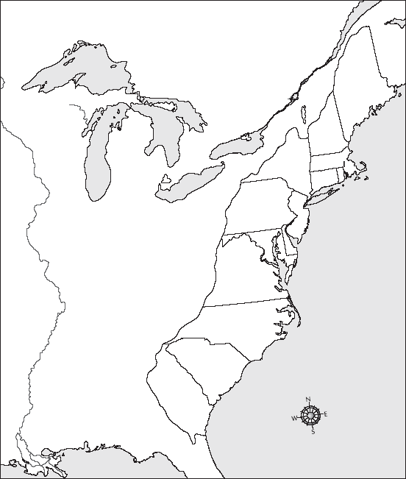
You can see that the colonies do not look the same as the states today. And yes, Massachusetts is located in two locations. Do NOT abbreviate colony names. Shade each colony a different color. Be Neat.
The 13 Colonies Map Activity
Connecticut
Draw arrows if the colony name does not fit in the map. See my example of Connecticut

Slide 5
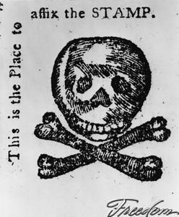
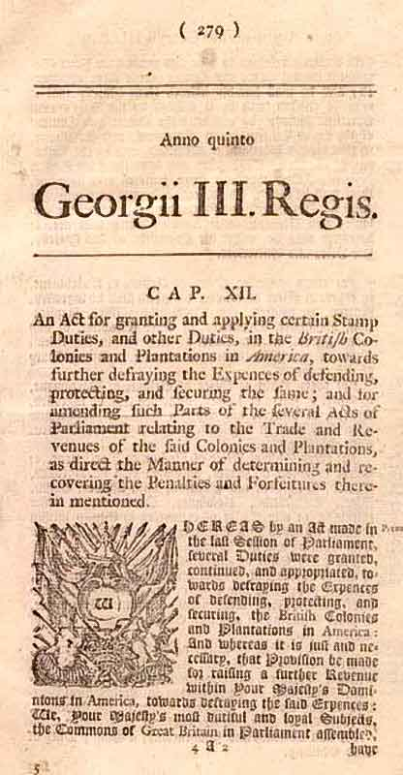
Colonists Express Discontent
Sugar Act 1764 (imposed import taxes)
Stamp Act 1765 (taxes on newspapers & pamphlets)
Forced Colonists to pay for Seven Year
& French &Indian War
Taxes to be paid by colonists!
“No taxation without representation,” Parliament passed Declaratory Act – Britain to have complete control over colonists!!! No Way – colonists were mad!

Slide 6
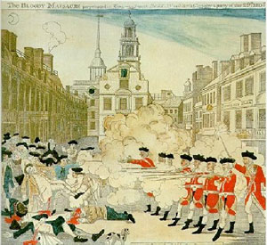
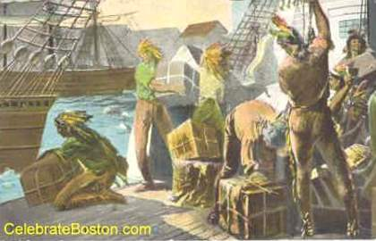
Colonists Rebel Against Britain
1770 – Boston Massacre – 5 protesters killed by British
1773 – Boston Tea Party – threw cargo of tea into harbor - protest tax on tea
Parliament passed harsh laws in Massachusetts to punish colonists

Slide 7
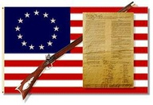
Colonists Declare Independence
Protects People’s Natural Rights
1775 – War in Lexington & Concord, Massachusetts
1776 – Declaration of Independence is drafted
Principal author – Thomas Jefferson
“Life, Liberty, and property”

Slide 8
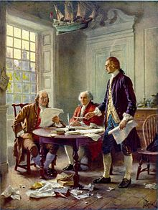
Yay for the 4th of July!!!!
Declaration includes John Locke’s Ideas:
People’s right “to alter or to abolish” unjust governments
Popular Sovereignty – all government power comes from the people
Jefferson said:
King had trampled colonists natural rights
Colonists had right to rebel
July 4, 1776 – Declaration of Independence adopted
Benjamin Franklin, George Washington & Thomas Jefferson working on the Declaration of Independence

Slide 9
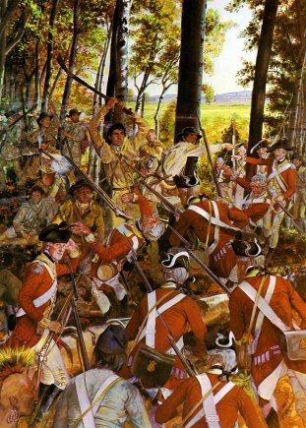
The American Revolution Continues
Americans lacked military sources
No money
Third of all colonists loyalists or wouldn’t fight
No training – no strategy
Americans had some advantages
Colonists were used to thick woods & rough terrain – guerilla warfare

Slide 10
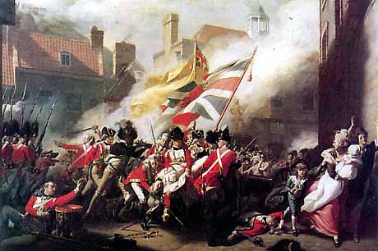
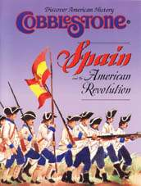
France Provides Support
1777 – Americans beat British at Battle of Saratoga
France (British rival) decided to help colonists

Slide 11
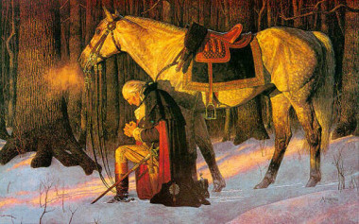
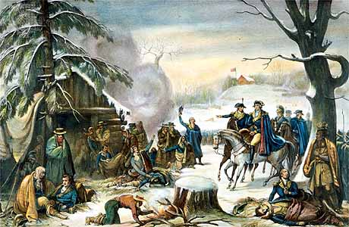
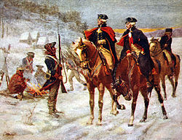
Valley Forge, Pennsylvania: 1777 – 1778 A Brutal Winter
2,000 died of influenza, typhus, typhoid, and dysentery
General Washington held troops together – patient, determined, courageous

Slide 12
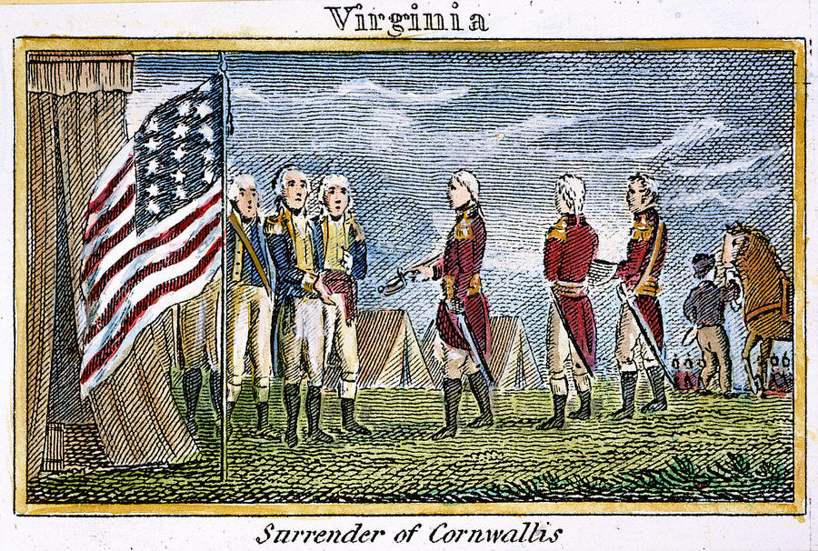
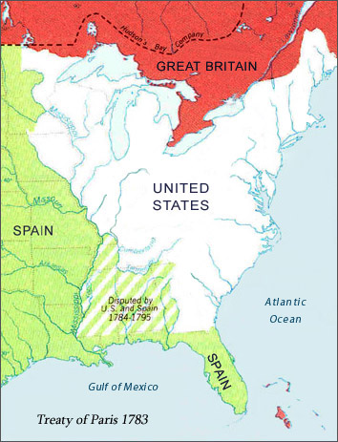
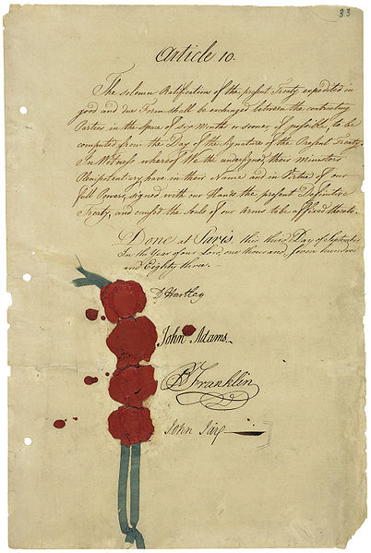
Treaty of Paris Ends the War!
1781 – French Fleet blockaded the Chesapeake Bay
Washington was then able to force the surrender of British Army at YORKTOWN, VIRGINIA
1783 – Treaty of Paris ends the War!
Signed by American, British & French diplomats
Britain recognizes independence of the United States of America

Slide 13
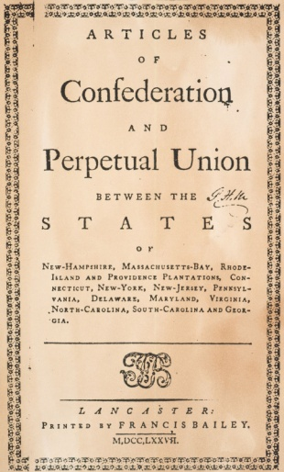
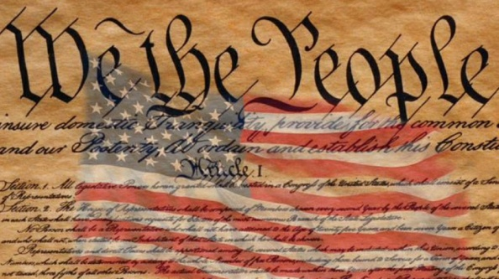
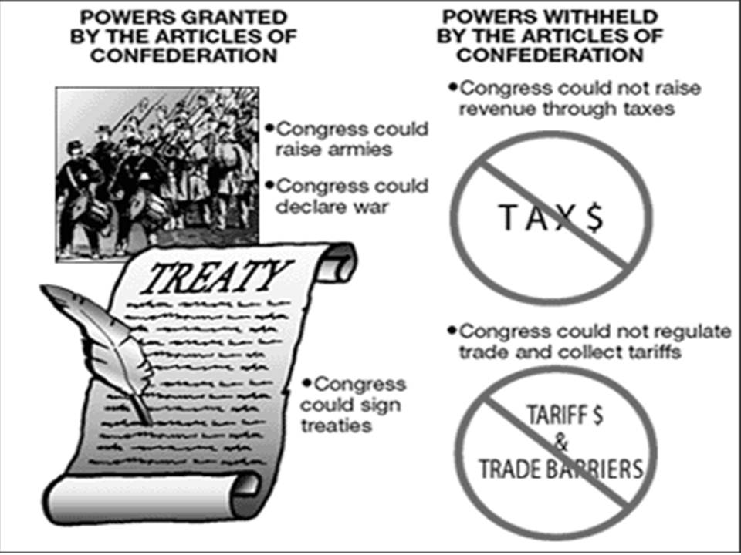
A New Constitution
The Articles of Confederation was the first Constitution
It was too weak to be effective
1787 – Redrafted the Articles to Create the Constitution: government run by the people, for the people

Slide 14
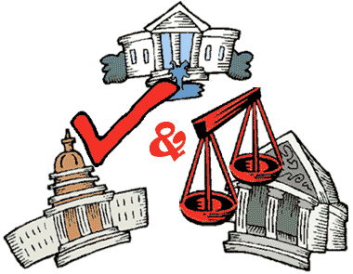
The Constitution created a FEDERAL REPUBLIC
Power is divided between the federal (or national) government and the states
Central feature of new federal government – Separation of Powers:
Legislative
Executive
Judicial
3 branches of government
This provides for checks and balances – No one branch holds too much power

Slide 15
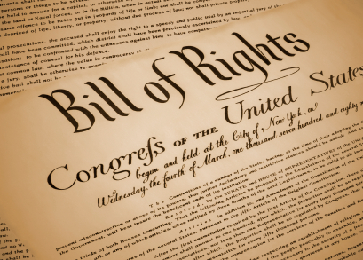
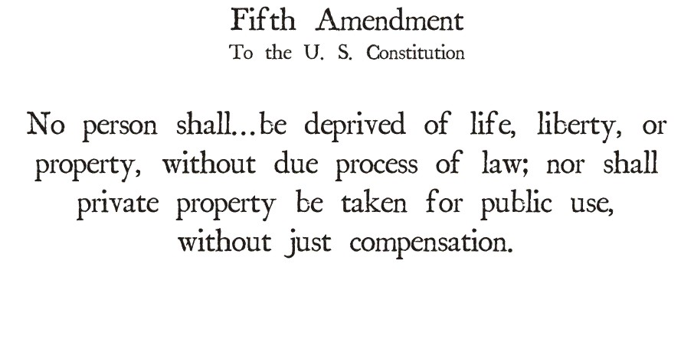
The Bill of Rights – the first ten amendments to the Constitution:
People had basic rights that the government must protect
Freedom of religion, speech and the press
1789 – The Constitution became the Supreme Law of the Land
It has endured more than 200 years!!!!

Slide 16
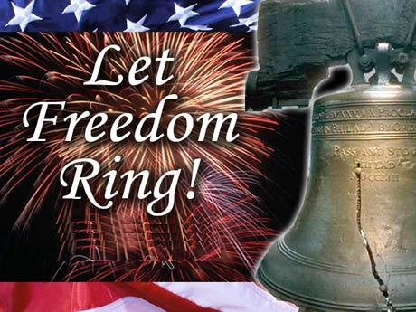
Symbol of Freedom
The Constitution and the New Republic were symbols of freedom to European countries and throughout Latin America
Its Constitution would be copied or adapted by many lands across the world
In 1789 the French Revolution toppled the monarchy in the name of liberty & equality
Others would soon follow!

